Slide 1

How Algorithms Keep You Scrolling
The Psychology & Neuroscience Behind Infinite Feeds

Slide 2

The Mechanics of the Feed
Explaining how variable rewards and UX patterns successfully hijack human attention.

Slide 3

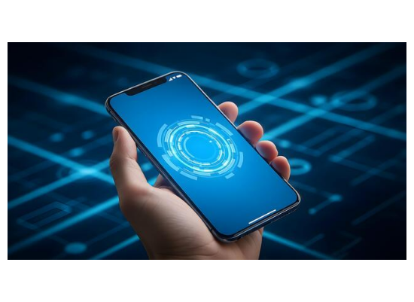
The Slot Machine in Your Pocket
▹
B.F. Skinner's Variable Reward Schedule: Unpredictable outcomes create significantly higher engagement than predictable ones.
▹
The Pull-to-Refresh Mechanism: Deliberately designed to physically mimic the lever of a casino slot machine.
▹
Anticipation over Reward: The largest dopamine release is triggered by the search itself, not just the content discovered.

Slide 4


Endless Feeds vs Stopping Points
Traditional Media
Infinite Feeds
Newspapers, Books, and Television broadcasts had natural stopping points and physical constraints that automatically allowed the brain to disengage.
TikTok, Reels, and Shorts remove all friction and stopping cues, keeping the brain locked in a state of passive, perpetual consumption.

Slide 5


The Scale of Digital Engagement
The Cost of Distraction
When attention is fragmented by frequent screen checks and notifications, it requires up to 23 minutes to fully regain a state of deep cognitive focus after a single digital interruption.
Average Daily Time Spent on Social Feeds

Slide 6
The Brain on Feeds
Uncovering the neurochemical cascade driving endless scrolling behavior.

Slide 7









Neurochemistry of the Scroll
Dopamine Loop
Limbic Dominance
Negativity Bias
Micro-doses of dopamine are consistently released in anticipation of novelty, creating a compulsive cycle.
Algorithmic feeds actively leverage high-arousal emotions, like outrage, to drive continuous interaction.
Long scrolling sessions reduce prefrontal cortex activity, bypassing rational choice and self-control.

Slide 8
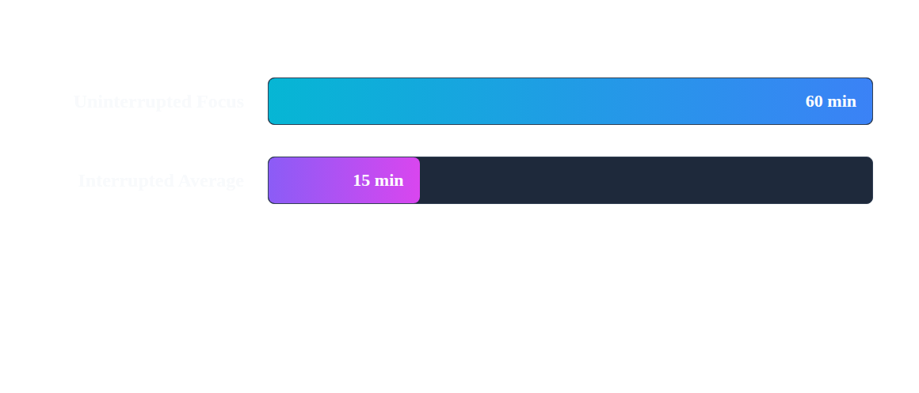
Focus Fragmentation & Workday Cost
Frequent social checking artificially lowers cognitive capacity. Moving between tasks in short, 15-minute bursts creates perpetual mental fatigue and significantly degrades the quality of work.

Slide 9

Reclaiming Your Attention
Grayscale Display: Remove vibrant visual triggers that naturally attract your eyes to notification badges and icons.
Intentional Friction: Log out of applications after use or move social folders off your primary home screen.
Time-Boxing & Boundaries: Establish phone-free zones, especially during morning routines and before bedtime.
Replacement Habits: Replace passive scrolling with low-dopamine, restorative activities like reading or walking.

Slide 10
Questions & Discussion
Thank you!
What strategies do you use to manage your screen time?

Slide 11

Image Sources
https://static.vecteezy.com/system/resources/thumbnails/079/592/555/small/high-tech-smartphone-display-showcasing-a-futuristic-digital-interface-with-glowing-concentric-circles-on-a-dark-abstract-background-free-photo.jpg
Source: www.vecteezy.com

